Slide 1
Perfect Studymate
Team name: Kapstone
이주용
천예원
황지희
Jorge

Slide 2
Motivation
1. Students often struggle finding specific terminology or information from a large volume of lecture materials
2. General ChatGPT may produce inaccuracies due to differing content and terminology from lectures students are taking
3. Using ChatGPT with lecture materials incurs additional costs
4. Using ChatGPT poses the danger of being biased towards its training data, and professors want answers based only on their material

Slide 3
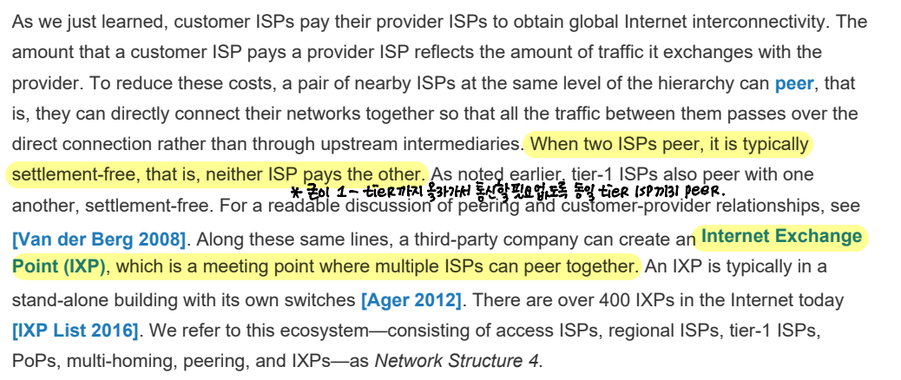

2. General ChatGPT may produce inaccuracies due to differing content and terminology from lectures students are taking
textbook
I want to know what network structure 4 is about!

Slide 4
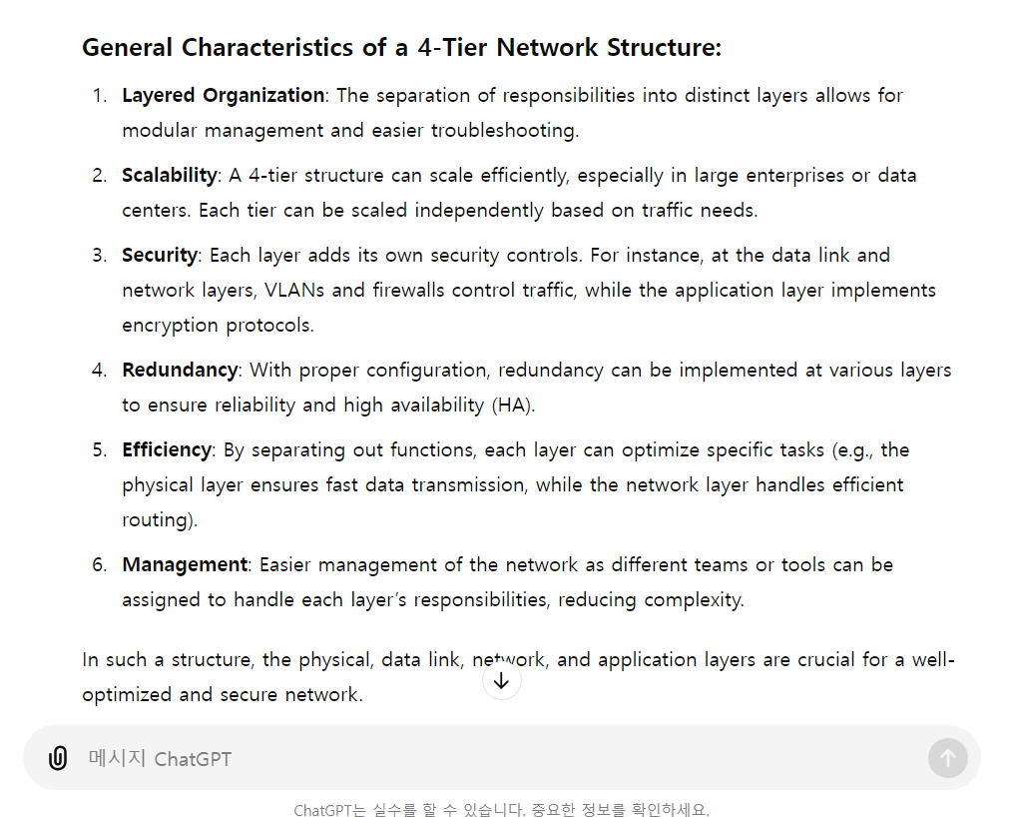

2. General ChatGPT may produce inaccuracies due to differing content and terminology from lectures students are taking
Hmm the results aren't very useful. ChatGPT is talking about different terms from what we learned in class.

Slide 5
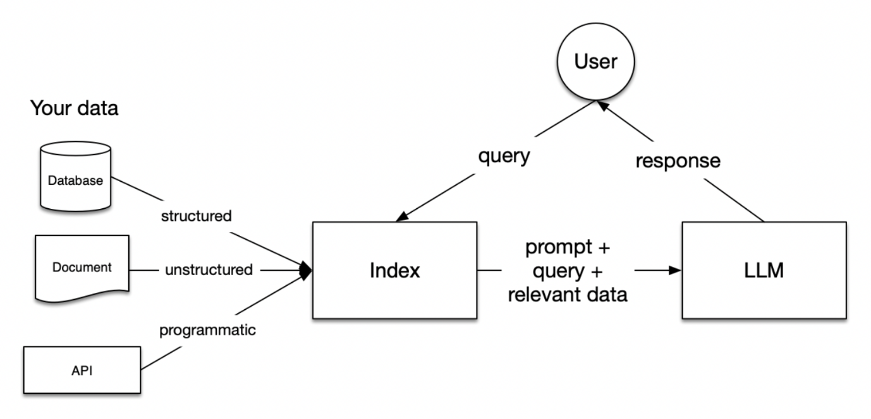
About our service
Our project utilizes a Retrieval Augmented Generation (RAG) architecture, allowing users to upload course materials (slides, PDFs, etc.) to interact with a specialized chatbot. This chatbot assists in studying, generates sample quizzes and exams, and answers specific questions related to the course.

Slide 6
Differentiation and Expectation
GoodNotes: Widely used by students nowadays but lacks a search function for all course materials, requiring users to search through individual files one by one.
https://www.goodnotes.com/kr
→ It can enhance students' learning experience and allows them to spend their study time more efficiently

Slide 7
Backup Ideas
PackRight(Working Title):
A luggage planner that provides legal information on prohibited items for specific airports
RecycleRight(Working Title):
A service that identifies recycling symbols from pictures user take and provides guidance on proper disposal methods

Slide 8
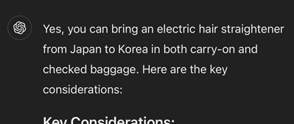
PackRight
Why?
Each airport has its own regulation for check-in and carry-on
Electric straightener allowed in Incheon Airport, but not in Kansai International Airport
Travelers often lose their item during security check
Beginners of traveling are especially prone to the problem
Certain items can be allowed based on kind of a product or customs regulations
What?
Chatbot that trains data from airport websites and tells if a searched item is allowed when departing from specific airport
https://www.tsa.gov/travel/security-screening/whatcanibring/all

Slide 9
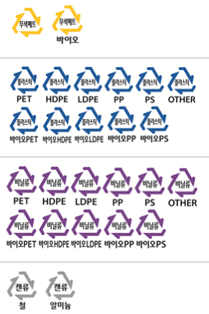
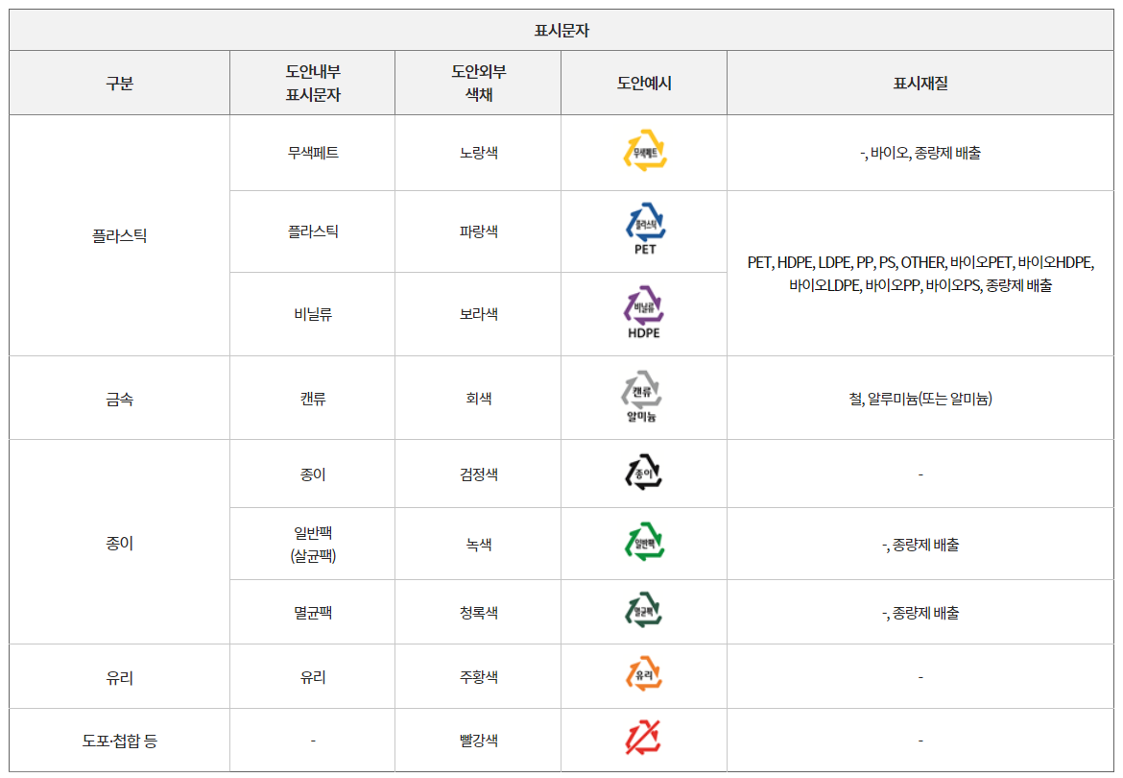
RecycleRight
- Useful for foreigners unfamiliar with Korean language and recycling regulations.
- Complex recycling symbols that are not very effective.
- Continuously revised recycling symbols
- Different waste separation methods by local government
사실 분리배출표시를 봐도 정확히 어떻게 버려야 할지 방법을 모를겠을 정도로 표시 자체가 실효성이 높지 않았다.
역시나 환경부의 대국민 온라인 설문조사에서도 분리 배출표시 개선이 필요하다는 의견이 72.3%나 된다. 분리배출표시가 도움은 되나 실효성이 부족하다는 의견이 66.9%였다.
출처 : 포인트경제(https://www.pointe.co.kr)

